Slide 1
BPMN2 Semantics & OBP2
A demonstration by LE ROUX Luka

Slide 2
Demonstrations
Part 1 : A simple BPMN2 model (V1 & V2)
“V1” Simulation & verification
“V2” Simulation & verification
Part 2 : One Way representative model
Simulation & deadlock
Again with “flow completion”
“Process 0” isolated
Ongoing work (MSP3 as a target)
Notes:
Une première partie illustrative suivie de son application au model du projet
La plus part des screenshots seront expliqués après la demo correspondante mais sont la pour permettre de repasser sur les slides sans la démo

Slide 3
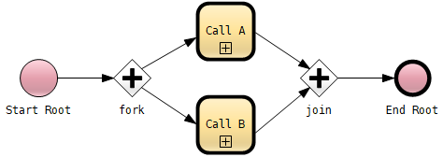



Part 1 : A simple BPMN2 model (2 versions)
Process Root
Process B (V1)
Process A
Process B (V2)

Slide 4
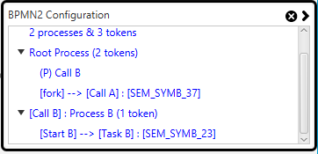

Part 1 : Simulation
Demo simulation (V1)
Example of a BPMN2 execution state and its associated actions:
Notes:
Simulation V1, “show everything”, do not spend too much time but do “rewind” once or twice to show OBP2 at work

Slide 5
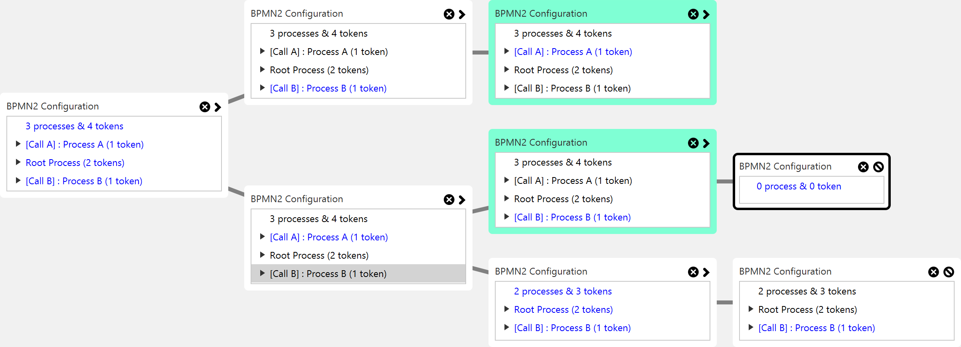
Part 1 : Simulation
The entire state space of V1 model with “flow completion”

Slide 6
Part 1 : Deadlock properties
All models that terminates have a “deadlock”, the following fails
We can filter out “expected deadlocks”
Alternatively, we can check that a process always terminates

Slide 7

Part 1 : Deadlock verification
Process B (V1)
The demonstration will show this is not verified on V1
This is due to “process B” potentially not being ready to “catch”
But if “Task B” ends before “signal” is thrown, the process terminates
Given the following atomic propositions :
Dwyers Pattern : After B, T responds to S
Translates in LTL to :
Demo verification (v1) : only “noDeadlock_iff” is verified

Slide 8
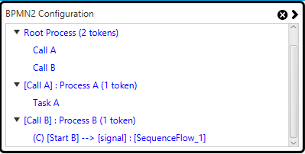
Part 1 : V2 & “Flow completion”
Process B (V2)
The symmetry reduction developed for One Way
One implication is to give priority to sequence flows over task actions
As such, in V2, process B is always ready to “catch”
Demo simulation & verification (V2) : “alwaysTerminates” now holds
Initial configuration with flow completion activated

Slide 9
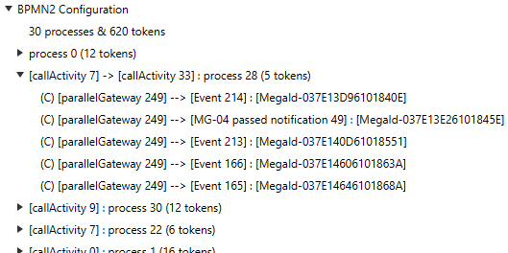


Part 2 : One Way representative model
Demo simulation & deadlock, with and without “flow completion”
Demo isolated process 0
Deadlock found in the model with “flow completion”
(a proper termination)
Deadlock found in the model without “flow completion”
Notes:
Model has 958 tasks and 475 signals, 958 + 475 = 1433

Slide 10
Ongoing work (MSP3 as a target)
Timed integration : BPSIM & atomic propositions
Algorithmics (bitstate hashing)
More “options” (isolate other processes ?)

Slide 11
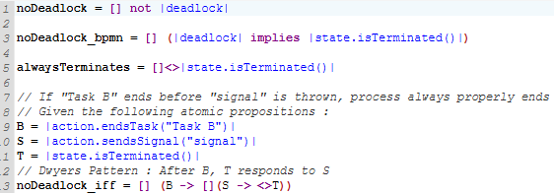
deadlock.gpsl

Slide 12
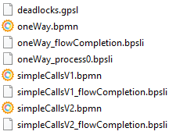

Files

